Slide 1




SEAI Warmer Homes Scheme
100% funded Fully funded
energy upgrades for certain homeowners
The SEAI Warmer Homes Scheme provides free home energy upgrades to homeowners who get certain social welfare payments.
These upgrades help improve your home's warmth and energy efficiency

Slide 2
Eligibility Criteria
1) You must own and live in your own home
This must be your main residence,
where you live most days of the week
2) Your home was built and occupied before 2006
This means the ESB meter was connected
and property was lived in prior to 2006
3) You receive one of the following welfare payments:

Slide 3
Welfare Benefits
Fuel Allowance as part of the National Fuel Scheme
Job Seekers Allowance for over six months
and have a child under seven years of age
Working Family Payment
One-Parent Family Payment
Domiciliary Care Allowance
Carers Allowance and live with the person you are caring for
Disability Allowance for over six months and have a child under seven years of age
If you receive any of these welfare entitlements, you can check your eligibility online. Be sure to read SEAI's privacy notice, as you agree to this and the scheme's terms and conditions by applying online.
If you recently started receiving any of the eligible welfare payments, allow 5-6 weeks from your first payment before making your application.

Slide 4
Upgrades Offered
These will be based on factors such as its age, size, existing heating system and condition.
The measures are then validated by your appointed contractor and recommended in line with scheme rules. Upgrades offered may include:
• Attic insulation
• Cavity wall insulation
• External wall insulation
• Internal wall insulation
• Secondary work such as lagging jackets, draught proofing and energy efficient lighting
• Renewable heating systems and windows are occasionally recommended (we do not support the installation of oil or gas boilers

Slide 5
Waiting times:
It is important to be aware that there are currently waiting times of up to 24 months
before your home energy upgrade is completed from receiving your application.
Applications are dealt with on a first-come, first-served basis.
The following are the current approximate wait times for each stage of the application process.
Pre-works BER* - Up to 12 months from application
Survey - Approx. 14 months from application
Works Completed - Approx. 24 - 26 months from application
Post works BER/Inspection - Approx. 2-3 months after works completed
*All homes participating in the programme must have a BER in place.
If you do not have a valid BER in place, SEAI will carry one out for you in advance of works taking place. This may impact waiting times for applicants.

Slide 6
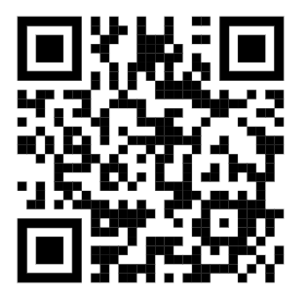
How to Apply?
1) Apply online:
https://onlinewhs.powerappsportals.com
This QR code brings you
to the Warmer Homes Scheme →

Slide 7
What to need to apply
MPRN
Eircode
PPSN
Date of birth
Proof of ownership*, plus any extra document if relevant
(*Your home insurance policy document)

Slide 8
What happens next?
Apply
BER arranged if needed
Home survey
Works and final BER / inspection

Slide 9
Thank you
KSEC Team
KSEC can help you check eligibility and fill in the form
SEAI makes the final decision and decides
which upgrades are suitable for your home

